Slide 2
Information Technology
David Sanchez, Chief Information Officer
Jim Hall, Chief Information Security Officer
Information Technology Advisory Committee
October 12, 2018

Slide 3
Agenda
Welcome
Information Security
Project Updates
Student IT Tech Survey
Discussion Topics

Slide 4
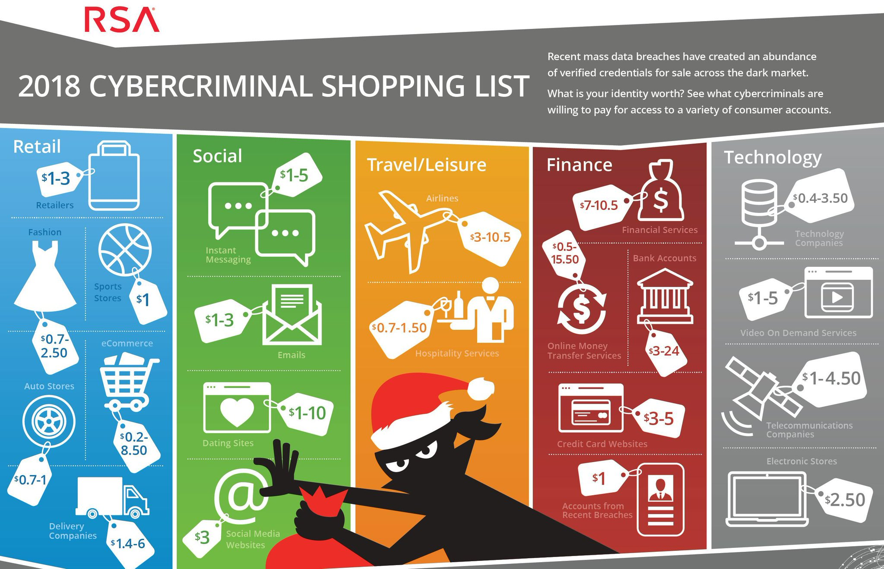
2018 Cybersecurity Landscape
Notes:
Standard Applications
Access
OneNote
Outlook
PowerPoint
Publisher
Word
Excel
Teams
OneDrive
Skype for Business
Both forms of the application are available. Web based as well as locally installed. Access is ONLY available for local installation.
OneDrive underpins it all. Microsoft’s answer to dropbox.
Access files anywhere
Work with anyone
Find files quickly with search capability
Has advanced encryption, compliance, and security features
1TB of storage PER USER
Can access from any PC, Mac, iOS, or Android device

Slide 5
Phishing – Keys To The Kingdom
76% of businesses/organizations say they experienced phishing attacks in 2017
By Dec 2017, the average user was receiving at least 16 malicious email per month
92% of malware is delivered using email as the initial vector
Fake invoices are the #1 disguise for emailed malware
Business email compromise cost organizations $676 million in 2017
All hands on deck!

Slide 6
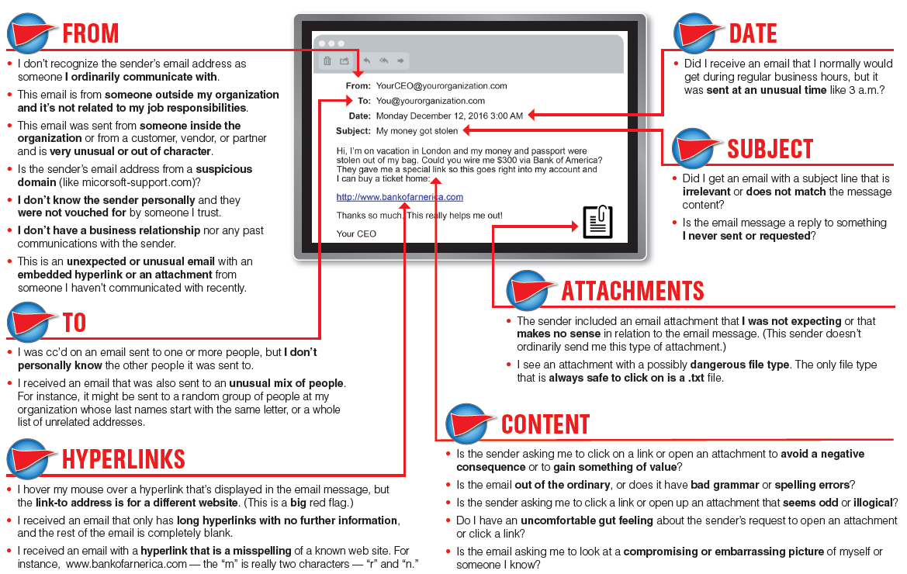
Phishing - Red Flags

Slide 7
Texas Senate Bill 1910
SB1910 references TX Government Code 2054. 2054:517 applies to higher education
Our processes and procedures for bringing web sites and mobile applications online that process confidential information MUST: (at a minimum)
Submit documentation to the Chief Information Security Officer describing:
1. Site or application architecture
2. Authentication mechanism
3. All administrator level access
BEFORE the site or application goes live, penetration and vulnerability testing must be done either internally or by an independent 3rd party.
An addendum to the Information Security Handbook for this requirement has been sent to the faculty senate chair and the staff senate chair.

Slide 8
Risk Assessment
October 22nd – Dec 7th
Assess and identify risk in critical IT systems.
Refresh work done in 2017 and plan for a refresh to take place yearly from now on.
Risk assessment report will be summarized and provided to the president and the cabinet by February of 2019.

Slide 9
Additional Cybersecurity Focused Activity
State of TX Information Security Plan (every even year)
42 categories
State Cybersecurity Roadmap
Controlled Penetration Testing
Weekly Vulnerability Scanning
Monthly Vulnerability Scanning of Hosted Application Sites
Departmental Discussions

Slide 10
Project Updates
Summer 2018
Dillard Classroom AV
Disaster Recovery – Flower Mound
Police move to Electra Circle
Phone-a-Thon move to Alumni House
Language Learning Computer Lab
Lifelong Learning Center
Radius CRM (Customer Relationship Management)
Computer Labs
Dillard 324 PC 50
Bea Wood PC 28
Hardin 225
Bolin CS Mac Lab 15
Geosciences PC 25
Bolin Math PC 31
Current/Continuing
Domain Name
Banner 9
Campus Wi-Fi
Campus Fiber
HSHS/New Data Center
Items Queued Up
Touchnet
Ad Astra
Office 365

Slide 11
Information Technology – Domain Name
New Branding - MSU Texas
Domain Change
Moving from mwsu.edu to msutexas.edu
6 months plus 6 month extension
Through February of 2019
Changes:
Email, portal, single sign-on, D2L, website
Update personal accounts linked to mwsu.edu
Update external websites, research publications, professional associations
Update email signature
https://msutexas.edu/it/domain-name-change.php

Slide 12
Information Technology – Banner 9
Why are we doing this?
Oracle’s Extended Support for Oracle Forms ending December 31, 2018.
No new features updates, fixes, security alerts, data fixes, and critical patch updates.
Ellucian moving Banner 8 administrative applications to Sustaining Support January 1, 2019.
Need to transition to Banner 9 Admin Pages (INB)
Does not impact Banner Self-Service/Webworld at this time.
What is changing?
Interface has a web look and feel
Navigation is different (banner keyboard shortcuts template)

Slide 13
Information Technology – Banner 9
What has been done.
Ellucian Solutions Manager
Single Sign-On
Testing in Qual
Banner 8 will still be available for several weeks as users learn how to work within Banner 9.
Website Information: https://msutexas.edu/it/banner/index.php

Slide 14
Technology Related Surveys
Student Government Survey Fall 2017
Two IT Related Questions
Core Data Survey – Educause 2018 (October)
Student Tech Survey Educause Spring 2018
Comprehensive Survey
124 Higher Education Institutions (2017)
10 Countries (2017)
539 MSU Students Responded
Year 2 in Spring 2019
Faculty Tech Survey Educause Spring 2019
Administered every other year
MSU will participate next year
157 Higher Education Institutions (2017)
7 Countries (2017)

Slide 15
Information Technology – Core Data

Slide 16
Educause Student Technology Survey 2018

Slide 17
Educause Student Technology Survey 2018

Slide 18
Educause Student Technology Survey 2018

Slide 19
Educause Student Technology Survey 2018

Slide 20
Educause Student Technology Survey 2018

Slide 21
Educause Student Technology Survey 2018

Slide 22
Educause Student Technology Survey 2018

Slide 23
Educause Student Technology Survey 2018

Slide 24
Educause Student Technology Survey 2018

Slide 25
Educause Student Technology Survey 2018

Slide 26
Educause Student Technology Survey 2018

Slide 27
Educause Student Technology Survey 2018

Slide 28
Educause Student Technology Survey 2018

Slide 29
Educause Student Technology Survey 2018

Slide 30
Educause Student Technology Survey 2018

Slide 31
Educause Student Technology Survey 2018

Slide 32
Educause Student Technology Survey 2018

Slide 33
Educause Student Technology Survey 2018

Slide 34
Educause Student Technology Survey 2018

Slide 35
Educause Student Technology Survey 2018

Slide 36
Educause Student Technology Survey 2018

Slide 37
Educause Student Technology Survey 2018

Slide 38
Educause Student Technology Survey 2018

Slide 39
Educause Student Technology Survey 2018

Slide 40
Educause Student Technology Survey 2018

Slide 41
Educause Student Technology Survey 2018

Slide 42
Educause Student Technology Survey 2018

Slide 43
Educause Student Technology Survey 2018
What is ONE thing you would like your instructors to do with technology to enhance your academic success?

Slide 44
Educause Student Technology Survey 2018
What is ONE thing you would like your institution to do with technology to enhance your academic success?

Slide 45
Technology Survey Summary
Student Related
Device Ownership – Students own an average of 3.5 internet capable devices – higher than our peers.
Students own laptops at the same rate as others but use them less in courses (14% lower in “all classes” category).
Strong home/off campus residence connectivity.
Higher percentage of students in fully online courses (10% higher).
Higher percentage of students who are “independent with dependents” (5% higher).
Higher percentage of students who work 30 or more hours (10% -12% higher)

Slide 46
Technology Survey Summary
Infrastructure Related
Wi-Fi rated across the board lower then comparison groups.
Good news – Wi-Fi improvements. Core infrastructure 2 new wireless controllers, NACs and older access points replaced.
D2L – utilization could be increased
Teaching and Learning Related
Preference for Face-to-Face Instruction
Underutilization of technology in class (laptops/phones)

Slide 47
Technology Survey Summary
Additional Information
Population 5,200 (Undergraduate emails)
Sample 549
Response Rate 10%
95% Confidence Level
4% Margin of Error

Slide 48
Questions
Comments
Concerns

