Slide 1

Information Technology Advisory Committee
February 9th, 2018

Slide 2

Agenda
Welcome
Information Security Update
Faculty Senate Feedback
Technology Surveys
Technology Updates
Open Discussion

Slide 3

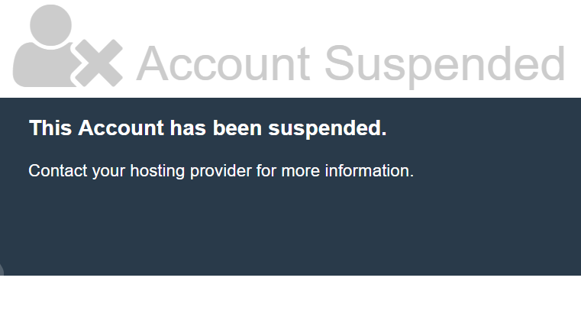
Information Security Recent Events
Domain Fraud
http://midwesternstateuniversityedu.org
Hosted with namecheap.com
Exact copy of mwsu.edu website
Hosted fraudulent emails
Hosted fraudulent phone numbers
Aimed at gathering I9 info – SEVIS fraud
Takedown notices were sent
3 days required to get the domain taken down

Slide 4
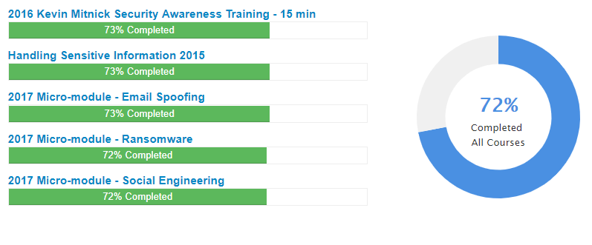

Information Security Recent Events
Security Awareness Training
Completion deadline extended to the end of April 2018
Next training year begins August 1st 2018.

Slide 5
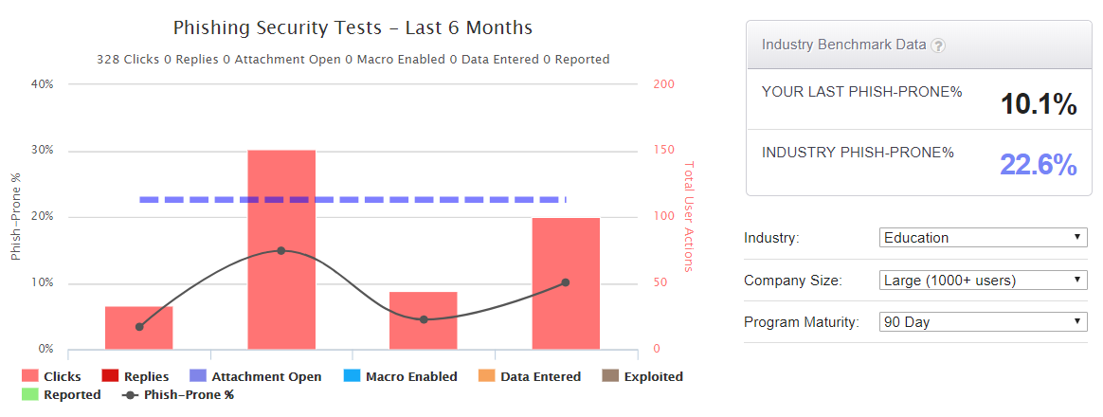
Information Security Recent Events
Targeted Phishing
Last phish: 10.1%
Industry average: 22.6%

Slide 6
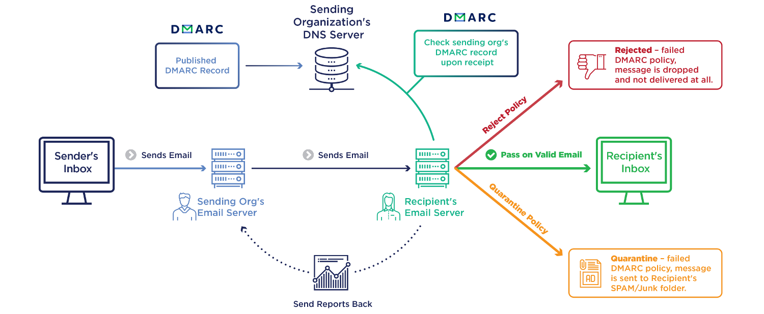
Information Security Recent Events
Domain Based Message Authentication, Reporting, Conformance
Aka DMARC

Slide 7
Information Security Recent Events
Campus Antivirus for Endpoint Protection
Current solution: Kaspersky Endpoint Security
Problem: Kaspersky has opened its codebase to 3rd party inspection in response to government concerns.
Options for next generation protection:
Dell Data Security – Cylance
Carbon Black
Sophos
Sentinel One
Symantec
Crowdstrike Falcon

Slide 8
Faculty Senate Feedback
Several Meetings Last Fall with focus on the Information Security Handbook
Heard Additional Feedback
  Improve ITAC Visibility
    Post Meetings on Campus Calendar
    Website with Agendas/Notes/PowerPoints
    Discussion/Feedback
  Enterprise Survey Tool SurveyMonkey – researched MSU stats/utilization
    179 total accounts with MWSU.edu domain
    48 total accounts with MWSU.edu domain that are active within the last year cost about $1,000.
      36 Free
      6 standard ($31 per month/per user)
      5 advantage ($34 per month/per user)
      1 premier (comped account, $99 per month/per user)
    Enterprise
      100 users 30k+ annually

Slide 9

Faculty Senate Feedback
Feedback Continued
  Too many passwords
    Employee Profile
    Pin Number
    Unifyed Single Sign On - Quicklaunch 4
    New programs tools connected through SSO
  Adobe Creative Cloud
  Faculty Survey
    Will participate in Educause 2019 Faculty Survey next February
  D2L integration with Turnitin
  Kaspersky

Slide 10

Technology Surveys
Student Government Survey Fall 2017
  Two IT Related Questions
Student Tech Survey Educause Spring 2018
  Comprehensive Survey
  124 Higher Education Institutions (2017)
  10 Countries (2017)
Faculty Tech Survey Educause Spring 2019
  Administered every other year
  MSU will participate next year
  157 Higher Education Institutions (2017)
  7 Countries (2017)

Slide 11
SGA IT Survey Questions

Slide 12
SGA IT Survey Questions

Slide 13
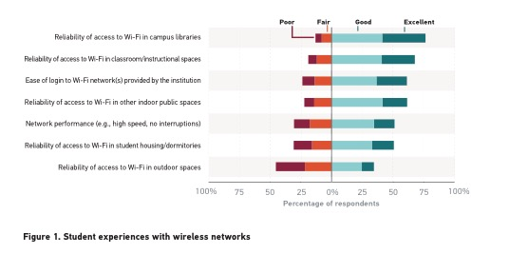
Educause Student Wi-Fi Experiences 2017
Reliability of access in libraries
Reliability of access in classrooms
Ease of login
Reliability of access in indoor public spaces
Network performance (speed, no interruptions)
Reliability of access in student housing/dorms
Reliability of access in outdoor spaces

Slide 14
Technology Updates
External Wi-Fi AP replacements
  January/February
Dillard Classroom Upgrade
  Vendor Bids Due in two weeks
Flower Mound
  Network Gear Arriving
  AV PO Processed
  Disaster Recovery out for bids
Campus Fiber Project
  Purchasing getting RFP out
  New Fiber Across Campus to Data Center in HSHS
Dell Discounts for Faculty, Staff and Students
  www.dell.com/mwsu
  Being developed

Slide 15
Technology Updates
PC Summary | Model | Total | Approximate Year Purchased
 | GX620 | 9 | 2005
 | OptiPlex 745 | 5 | 2006?
 | OptiPlex 755 | 89 | 2007
 | Precision T7400 | 1 | 2007
 | OptiPlex 760 | 93 | 2008
 | Precision T3400 | 3 | 2008
 | OptiPlex 780 | 93 | 2009
 | OptiPlex 380 | 84 | 2009/2010
 | OptiPlex 390 | 1 | 2010
 | Optiplex 790 | 4 | 2011
 | Area 51 | 1 | ?
 | Misc. | 4 | ?
Total: |  | 387
Faculty and Staff Computer Lifecycle
  Fall 2017 – 21 PC’s
  Spring 2018
    Macs = 9 (2009-2013)
    PC = 115 – 120 (2005-2007)

Slide 16
Discussion and Committee Feedback

Slide 17
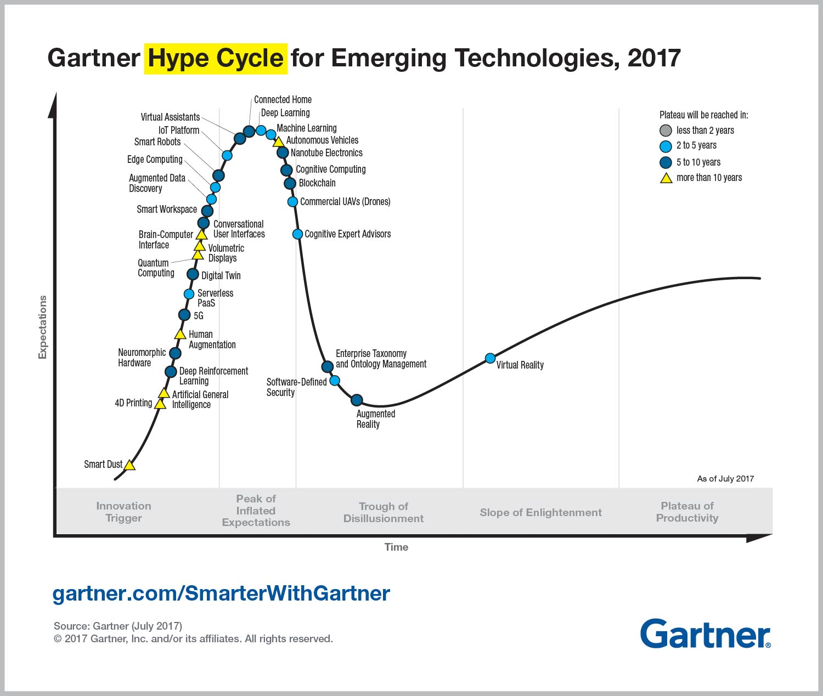
Discussion and Committee Feedback

Slide 18


